Slide 1
Industry Information Session
Brown Marmorated Stink Bug (BMSB) Seasonal measures
August 2023
Caryn Scott, A/g Director, Hitchhiker Pests Policy

Slide 2
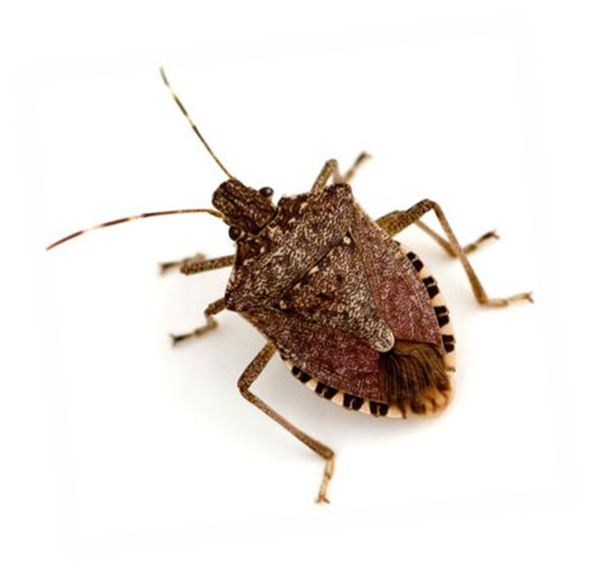
Agenda
Acknowledgement of country
Review of the 2022-23 BMSB season
Measures for the upcoming BMSB season
Target goods, countries, dates
Containerised vs break bulk
NUFT and 120 hours
BMSB treatments
Vessels
Issues and learnings from 2022-23
Questions
Notes:
​I acknowledge the Traditional Custodians of the land we are meeting on, the Gadigal of the Eora Nation. I acknowledge and respect their continuing culture and the contribution they make to the life of this city and this region. I extend that recognition to the Traditional Custodians of all other lands on which you are gathered today and to all Aboriginal and Torres Strait Islander peoples attending today's event
We will take questions at the end
Please note we are policy teams that oversee the BMSB and offshore treatments measures, we will not be able to answer any questions in regards to staffing and inspection times.

Slide 3
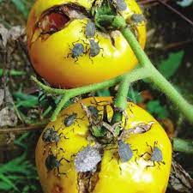
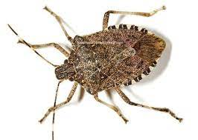
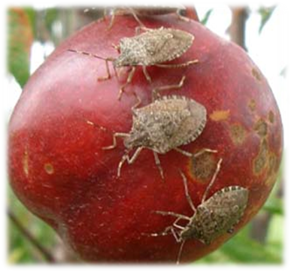
Brown Marmorated Stink Bug
Ranked 9 on Australia’s National Priority Plant Pests list
Potential to severely impact Australian and New Zealand agricultural industries
BMSB is known to feed on around 300 different plant species
Juveniles and adults feeds on, and severely damage fruit and vegetable crops
Notes:
BMSB is ranked number 9 in the National Priority Plant Pests list and It is also listed in the Exotic Environmental Pest List (EEPL)
If any exotic species (including BMSB) became established, they would cause significant damage to our environment including our unique native plants, animals and First Nations heritage sites.
Historically, biosecurity systems were built to manage limited threats that evolved slowly or not at all. We now face multiple threats on multiple fronts, including from our near north. FMD, varroa mite, lumpy skin disease are some of the current threats you would have heard about
Border and import controls remain critical but other risk pathways are increasing in importance.​
Contributing factors to biosecurity pressures:​
shifting climate & environmental conditions​
greater volumes and increasingly complex supply chains ​
limitations in detection and diagnostics capabilities
increase in illegal activity and malicious actors​

Slide 4
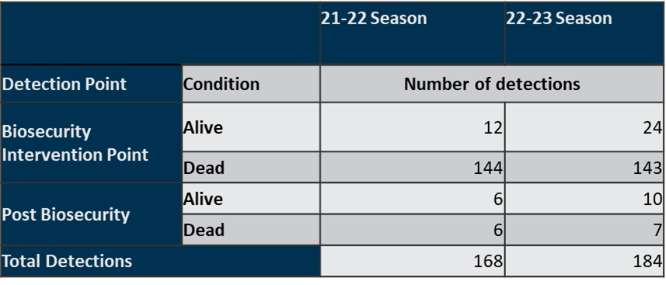
2022-23 BMSB Season - Review
Offshore treatment providers
232 registered across 25 countries
Intervention
BMSB Profiled consignments:
59,417 document assessments
8,321 Inspections
Whitelisted 61,572 consignments that were treated offshore
AEPCOMM for BMSB was used on 5,199 FIDs
The department directed 62 consignments for export due to arriving non-compliant to import conditions regarding mandatory offshore treatment requirements
Notes:
The number of detections of live BMSB for the 2022-23 Season doubled
BMSB profiled intervention included approximately 40,000 consignments directed for onshore treatment.
We had a 14% increase in use of AEPCOMM for BMSB goods compared to 2020-21 BMSB season. Overall use of AEPCOMM on BMSB goods was a little over 20%
There were over 61,000 consignments whitelisted due to being treated offshore.
directed 65 consignments for export due to arriving non-compliant to import conditions. This includes 14 break bulk consignments and 48 open top and flat rack containers arriving untreated. 8 of these exceeded the 120 hour post treatment window requirements and 3 FCL consignments arriving untreated that were unable to be treated onshore.

Slide 5
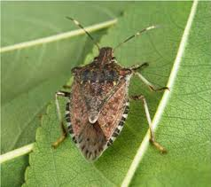
2023-24 BMSB Seasonal Measures
Uzbekistan has been added this season
Measures apply to goods shipped between 1 September and 30 April (inclusive) as sea cargo. Any target high risk or target risk goods manufactured in, or shipped from a target risk country are subject to the BMSB seasonal measures
Target high risk goods – mandatory treatment
Target risk goods – subject to random inspection
Any vessel that berths at, loads or tranships goods from these countries are also subject to heightened vessel surveillance
Emerging risk countries - UK and China only
Notes:
The risk season applies to 1 Sept – 30 April each year. We have removed any references to years on our webpage as BMSB is now BAU.
going forward you won’t see many big announcements. Industry advice notices will be published to remind that the season is starting/ending, and if there are any changes to the measures. This will also be the last year that we are holding these sessions.
Going forward please check our webpages as all relevant information will be there.
Measures are for goods arriving into Australia as sea cargo
Shipped on board is defined by the date on the Bill of Lading. This does not refer to the vessel departure date.
Emerging risk countries changed will remain as China and UK - will also see chapters 39, 94 & 95 targeted for random inspections.
This will not apply to target risk countries.
39 - plastics
94 – furniture
95 –toys and games
All target high risk chapters – inspection only for emerging risk

Slide 6
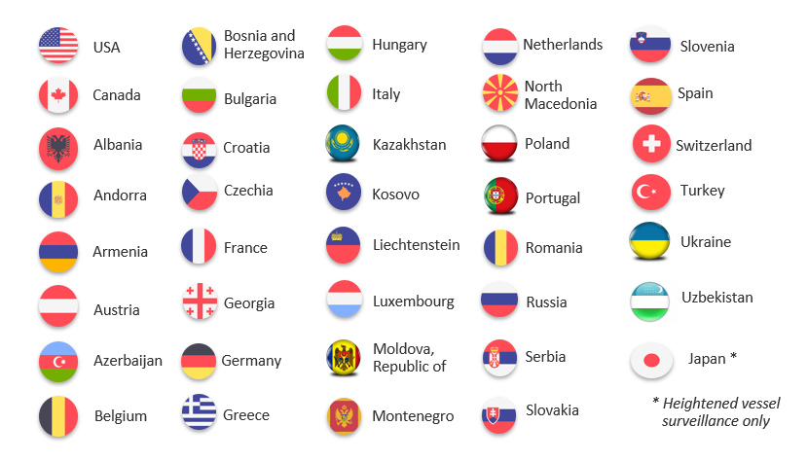
Target risk countries
Notes:
The department gets a handful of detections of BMSB from China each year
BMSB is native to Asia, and there are native predators, parasites and diseases that limit the BMSB population on that continent.
Usually numbers of BMSB found are low in number (generally less than 10).
It is estimated that there may have been between 3000 – 5000 bugs within the five

Slide 7
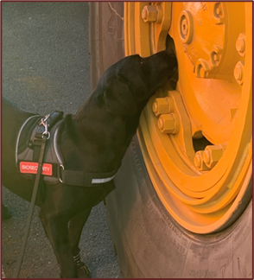
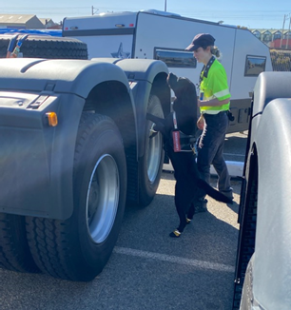
2023-24 measures continued
Three approved BMSB treatments:
Methyl Bromide
Sulfuryl Fluoride
Heat Treatment
All target high risk and target risk goods will be subject to random verification inspections
Includes post treatment verifications
Includes random inspections of risk goods
Inspections of goods from emerging risk countries
All random onshore verification inspections must be conducted in a metropolitan location.
Notes:
Change the verification regime to Inspect (unpack) directions instead of Secure Seals Intact inspection directions. This will put the onus of managing live pest risk onto the Approved Arrangements (AA) under the conditions of their operations.
AAs will be directed to collect container sweepings for each consignment.
This will allow AAs to unpack containers prior to inspection. Alleviates demurrage charges on container for importers.
Reduces the inspection booking times required for ASG. Inspection bookings times should be able to be reduced to 30 mins (currently around 2-4 hours) which in turn will reduce booking delays.

Slide 8
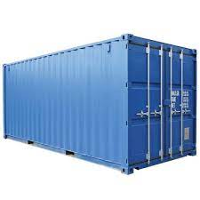
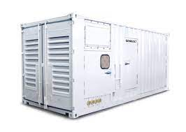
Containerised vs Break Bulk
Containerised:
Refers to 6 hard sided containers - general purpose/dry box
Refrigerated containers (operating or non-operating) fall into this category and are subject to the measures
Has the option for onshore treatment
Must be sealed within 120 hours of treatment completing (if treated prior to 1 December)
Break bulk (includes flat rack and open top containers)
All target high risk goods shipped as break bulk must be treated offshore
No allowances will be made for untreated break bulk and goods will be directed for export
Must be shipped on board within 120 hours of the completion of treatment (if treated prior to 1 December)
FCL containers that have been modified, such as those used to house in-built power generators, portable workshops etc; are break bulk
Notes:
If you do wish to ship target high risk goods inside a reefer, please ensure the goods are treated prior to packing
Onshore treatment of containerised goods will be managed at the container level
This means that goods cannot be removed/deconsolidated and treated separately
Completion of treatment refers to:
When ventilation started for fumo
When heat treatment finishes
Break bulk, open tops (in gauge) and flat racks must be treated offshore by an approved offshore BMSB treatment provider

Slide 9
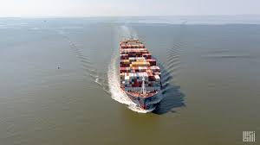
120 hour window – Post Treatment and Transhipping
Goods treated in a target risk country are subject to the 120 hour post treatment window when treated prior to 1 December
Containerised goods must be sealed in the container
Break bulk goods (incl FR and OT) must be shipped on board the vessel
If break bulk has been shipped outside the 120 hour window (but less than 48 hours over), and evidence can be provided, the in-transit policy may be enacted.
The 120 hours does NOT apply to:
Goods treated in non-target risk countries
Good treated after 1 December
Breakbulk goods that tranship in a target risk country prior to 1 December, are subject to the 120 hour window. Does not apply to sealed containers.
Notes:
The shipped on board date as indicated on the bill of lading is used to determine the 120 hours. This is the date the goods are loaded onto the vessel.
The vessel departure date is not used to calculate the 120 hours.
If your goods tranship in a target risk country, they are also subject to the 120 hour window. This includes different ports within the same country
The 120 hour transhipment window does not apply to goods arriving in the target risk country from 1 Dec onwards.
Goods transhipping in a non target risk country are not subject to the 120 hour window
Where untreated/non-compliant BB tranships in a non-target risk country on the way to Australia, we recommend to have the goods treated in these ports to avoid export.

Slide 10
New, Unused and Not Field Tested (NUFT)
From 1 December, certain tariffs that can meet all the BMSB NUFT criteria will not be subject to mandatory treatment.
Manufacture must have started on or after 1 December of the current BMSB risk season; and
classed as new machinery, vehicles, vessels/new complex parts and equipment, and are classified under the following tariff chapters only: 82, 84, 85, 86, 87, 88 and 89; and
Accompanied by a BMSB NUFT manufacturer’s declaration (that meets minimum documentary and import declaration requirements policy)
If NUFT criteria is not met, the goods may be directed for export or onshore treatment (containerised only)
NUFT declaration MUST state the manufacture start date
Notes:
NUFT criteria has been clarified for this season
address locality removed
In addition to Minimum Documentary and import declarations policy requirements for manufacturers declarations (sections 4.6.1), your BMSB NUFT Manufacturers declaration must :
contain the statement “the product is new, unused and not field tested”
Must have a manufacture start date.

Slide 11
BMSB Onshore Treatment
Three approved arrangement (AA) classes support onshore treatment providers to manage BMSB:
12.1 - Methyl Bromide fumigation,
12.2 - Sulfuryl Fluoride fumigation and
12.3 - Heat treatment
Class 4.7 AA site
Class 4.7 allows a container unpack within a secure environment to enable effective treatment of the goods.
Requests must be sent by the treatment provider to the Onshore treatments team via email (treatments@aff.gov.au).
To reduce delays at the border, the department recommends that industry treat offshore or pack containers to allow effective onshore treatment.
If onshore treatment is a preference, please refer to the BSMB consignment suitability factsheet: https://www.agriculture.gov.au/biosecurity-trade/import/before/brown-marmorated-stink-bugs/offshore-bmsb-treatment-providers-scheme/treatment-guidance
Notes:
Where treatment cannot be performed at the container level (eg overpacking or plastic wrap), options are export or treatment at 4.7AA (secure unpack for treatments of seasonal hitchhiker biosecurity pests)
4.7 cannot be used as a first option for treatment or for the purposes of splitting a consignment to treat select lines. All goods must still be treated
Requests for must be sent by the treatment provider to the Onshore treatments team via email (treatments@agriculture.gov.au) for actioning.
If your preference is to treat onshore, please refer to the consignment suitability factsheet which can be found on the BMSB Offshore treatment providers scheme page

Slide 12
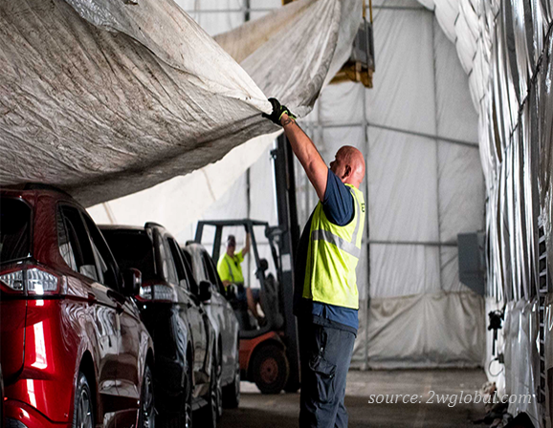
Offshore BMSB Treatment Providers Scheme
The Scheme continues for the 2023-24 BMSB season
All treatment providers in target risk countries that intend to conduct BMSB treatments must register on the scheme
Treatment providers in non-target risk countries that intend to conduct BMSB treatments are encouraged to register on the scheme
Treatment providers must re-register for the 2023-24 season
All applicants must demonstrate their ability to meet all requirements of the scheme and the treatment types they wish to conduct
Registration allows BMSB treatments to be conducted for both Australia and New Zealand

Slide 13
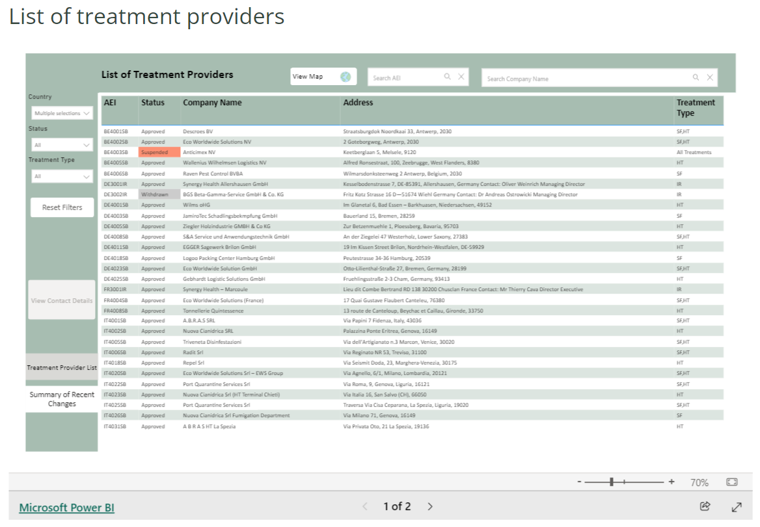
Offshore BMSB Treatment Providers Scheme – the List of treatment providers
Target high risk goods treated in target risk countries must be treated by a treatment provider listed as ‘approved’ on the List of treatment providers.
Offshore Treatment Provider webpage: https://www.agriculture.gov.au/biosecurity-trade/import/before/prepare/treatment-outside-australia/offshore-treatment-providers
Approved treatment providers are added to the list as they complete their registration renewal (99 as of 7 August). This will continue in the lead up to 1 September.
Importers/Exporters use this list to check for most up-to-date details of offshore treatment providers.
Notes:
One website for all offshore treatment providers – this was launched on 3 July 2023
Searchable function
You cannot tell what scheme the treatment providers are registered under on the List.
The slight wording change of requirements reflects that
The intent of the requirements remain the same

Slide 14
Vessels
Heightened vessel surveillance for all roll-on/roll-off (ro-ro) vessels will be applied through pre-arrival reporting
Vessel operators will be required to conduct self-inspections and report any detections of BMSB and other exotic insects
All ro-ro vessels that berth at, load or tranship from the target risk countries, will be required to undergo a mandatory seasonal pest inspection on arrival in Australia
Vessels approved under the Vessel Seasonal Pest Scheme ay be subject to may be subject to reduced intervention such as a reduction in mandatory seasonal pest inspections

Slide 15
2022-23 BMSB Season – Issues & learnings
Not treating BB, OT, FR prior to loading – exported on arrival in Australia
If transhipping, please treat in that port of call
Onshore treatment will not be permitted
Exceeding 120 hour post treatment window
Start of season and near 1 Dec
Mixing untreated target high risk goods with non target risk goods
Removal of lines will not be permitted
BMSB NUFT
Only applies to certain tariffs – do not mix tariffs
Applies to start date not end date
Refers to current BMSB risk season
Incorrect details for MC declarations
Detail in ICS does not match what is in MC declaration so will not go through to processing

Slide 16
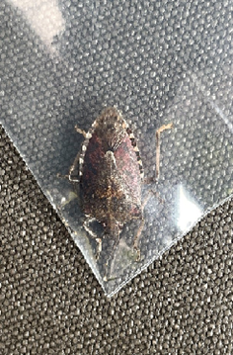
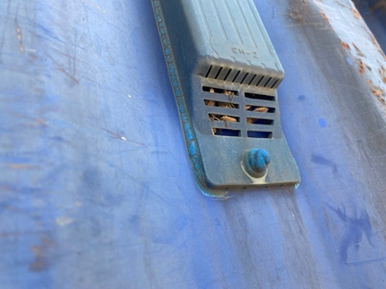
Summary
The main measures remain unchanged.
Uzbekistan has been added as a new country
All break bulk, flat racks and open tops (including in-gauge) MUST be treated offshore prior to arrival into Australia
If goods have been shipped untreated and are transhipping, have them treated in the transhipment port to prevent export
If you become aware of untreated break bulk prior to arrival advise the department at spp@aff.gov.au
Tariff 39, 94 & 95 are subject to random inspection for emerging risk countries only

Slide 17
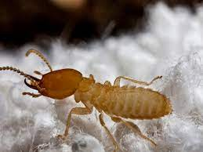
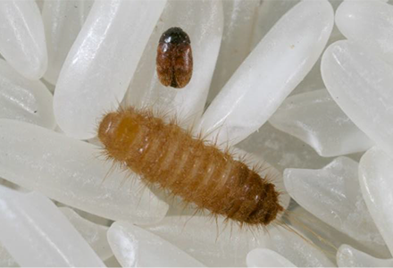
Industry’s role in biosecurity
See. Secure. Report.
Working with offshore suppliers to manage not just BMSB risk, but all pest risks
Recommend watching webinar: Managing the risk of a serious hitchhiker pest
https://www.agriculture.gov.au/biosecurity/australia/public-awareness/webinar-series

Slide 18
Stay updated
Stay updated on the BMSB seasonal measures by visiting the following webpages
www.agriculture.gov.au/bmsb
Subscribe to our Import Industry Advice Notices to get updates on changes to import requirements, including updates on Brown marmorated stink bug seasonal measures:
https://subscribe.agriculture.gov.au/subscribe
Any questions relating to:
Policy for hitchhiker pests can be emailed to: spp@aff.gov.au
Safeguarding can be emailed to: safeguarding@aff.gov.au
BMSB treatments can be emailed to: BMSBtreatments@aff.gov.au

